Slide 1
Michael Burbine
AP MACROECONOMICS
AP MICROECONOMICS
AP STATISTICS
SPONSOR: MATH TEAM, MOODY MATH CHALLENGE, GSMST’S ANNUAL MATH TOURNAMENT, STOCK MARKET GAME

Slide 2
A LITTLE ABOUT ME….
UNDERGRADUATE IN HISTORY AND ECONOMICS
MASTERS IN TEACHING ~CURRICULUM AND INSTRUCTION WITH A FOCUS ON SECONDARY MATHEMATICS
POST GRADUATE / CERTIFICATION WORK IN GRAPHIC AND WEBDESIGN
STATISTICAL ANALYSIS FOR PRIVATE CLIENTS
PRIVATE TUTORING FOR GRADUATE STUDENTS IN STATISTICS

Slide 3
COMMUNICATION

Slide 4
Tutoring Times
Via Text Message Throughout the Day
Mornings 7:35 to 7:55
For Seniors, 7th Period
After School, Tuesday Through Thursday, 3-4

Slide 5
Grading Practices
Economics
CLASSWORK | 10%
HOMEWORK | 5%
SPG | 5%
MIDTERM | 5%
QUIZZES | 20%
MILESTONE | 20%
PERFORMANCE FINAL | 5%
TESTS | 30%
CLASSWORK | 10%
HOMEWORK | 5%
SPG | 5%
MIDTERM | 5%
QUIZZES | 20%
FINAL EXAM | 15%
PERFORMANCE FINAL | 5%
SUMMATIVE | 35%
Statistics

Slide 6
HOMEWORK EXPECTATIONS
2 ASSIGNMENTS A NIGHT
ECONOMICS
WATCH A SHORT VIDEO, ANSWER A FOLLOWUP QUESTION (5 MINUTES)
MC PRACTICE-10 QUESTIONS (18-22 MINUTES)
Or
READING GUIDE (30 MINUTES)
STATISTICS
1 FREE RESPONSE QUESTION (6-8 MINUTES)
1 MC PRACTICE (18-22 MINUTES)

Slide 7
SPECIAL PROJECTS
ECONOMICS
SUMMER BUDGET PROJECT
MILESTONE PREP PROJECT
AP EXAM PREP PROJECT
STATISTICS
SUMMER READING PROJECT
AP EXAM PREP PROJECT

Slide 8
SPECIAL TESTS…
ECONOMICS
GEORIGA MILESTONE (DECEMBER)
AP MACRO EXAM (MAY); AP MICRO EXAM (MAY)
PREP PROJECTS
REVIEW OLD TESTS
REVIEW PACKETS & STUDY SESSIONS
STATISTICS
AP STATISTICS EXAM (MAY)
PREP PROJECT (ASSISTMENTS)
REVIEW OLD TESTS
REVIEW PACKETS AND STUDY SESSIONS
STUDENTS RECEIVE WRITE IN PREP BOOK IN AUGUST

Slide 9
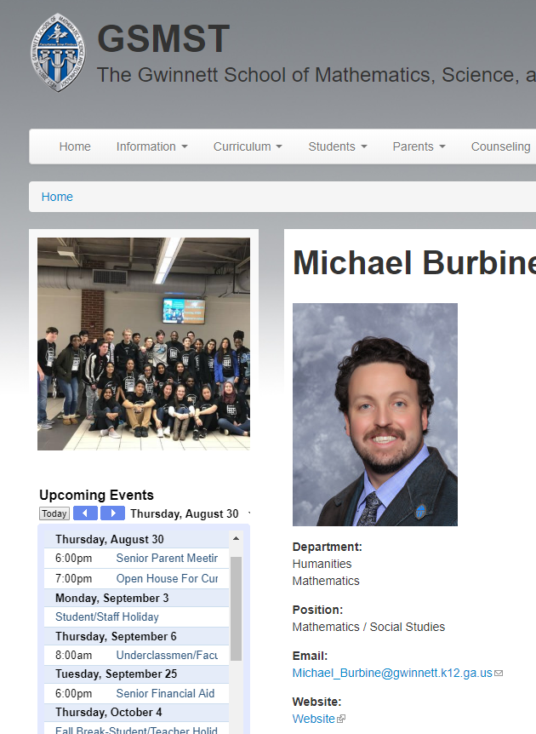
BEST WAY TO REACH ME…

Slide 10
MY PLAN TO CONTACT YOU…

Slide 11
MIDTERMS

Slide 12
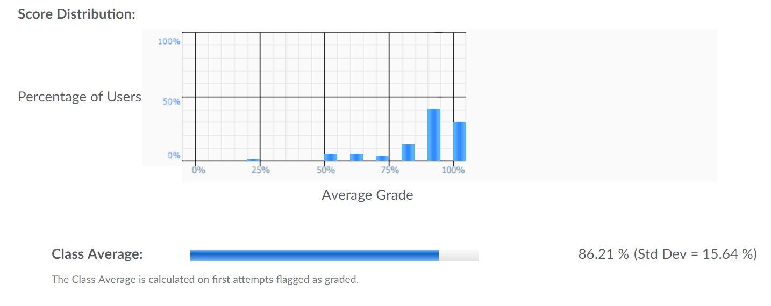
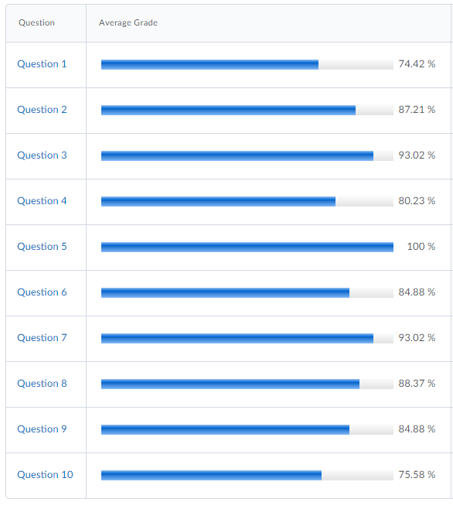
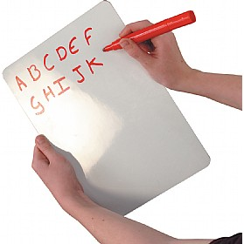
FORMATIVE ASSESSMENT

Slide 13
THE ECON TEAM….
ECONOMICS
DR. FUNK
MR. BURBINE
SAME CALENDAR IN TERMS OF QUIZZES, CLASSWORK AND MOST IMPORTANT….TESTS!
STATISTICS
I AM ALL ALONE….SO WE MOVE ON WHEN THE STUDENTS ARE READY!

Slide 14
STUDENT ENGAGEMENT
1. WALK THE WALK AND TALK THE TALK. IN OTHER WORDS, STUDENTS WHO CAN ENGAGE THE MATERIAL AND SPEAK THE MATERIAL USUALLY DO BETTER OFF.
2. DON’T MEMORIZE, FOCUS ON UNDERSTANDING.
3. ASK QUESTIONS. SITTING THERE CONFUSED IS THE BEST WAY TO STAY CONFUSED.
4. DON’T BE AFRAID TO BE WRONG. MAKE MISTAKES ON YOUR HOMEWORK SO THAT YOU GET THEM RIGHT ON THE TEST!

Slide 15
RIGOR…

Slide 16
RELEVANCE OF ECONOMICS

Slide 17
RELEVANCE OF STATISTICS
RELEVANCE OF STATISTICS

Slide 18
OUR CLASSROOM….

Slide 19
Q&A

